Slide 1

Report of network discovery & mapping
Findings summarizing

Slide 2
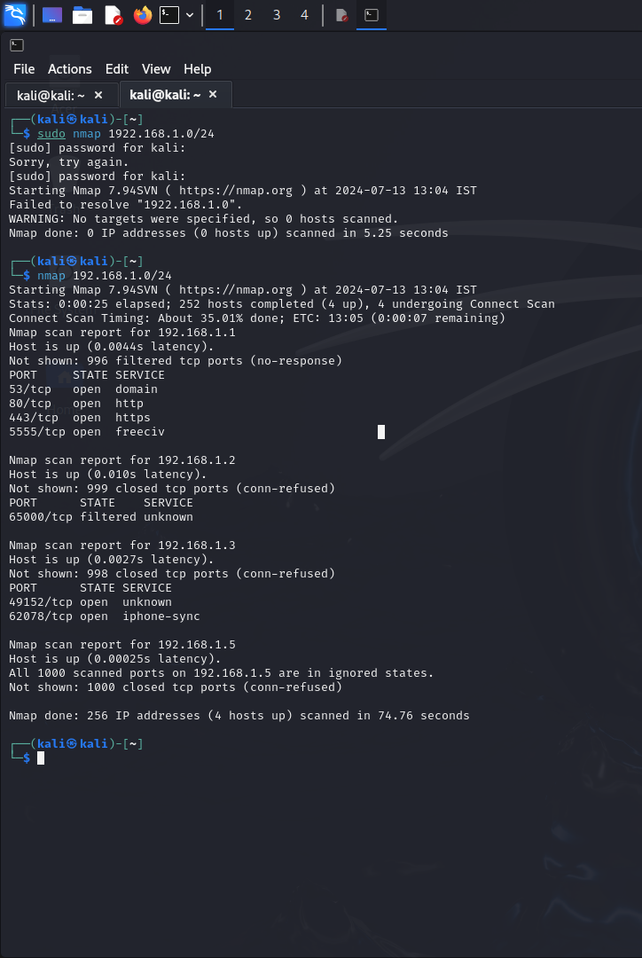
Network Discovery (scanning)
What is network discovery or scanning ?
Network discovery is the process of identifying and locating all devices, systems, and services connected to a computer network. This includes identifying various Internet resources, including their IPs, MAC addresses, operating systems, and the services they host. Network discovery helps administrators understand what devices are on the network, how they communicate with each other, and their current status.
Using Nmap we can discover devices that are connected to the targeted network which we were scanning
While scanning to the network we discover four device that are connect to the network
Four host with IP addresses , MAC addresses, operating system and ports/ services

Slide 3
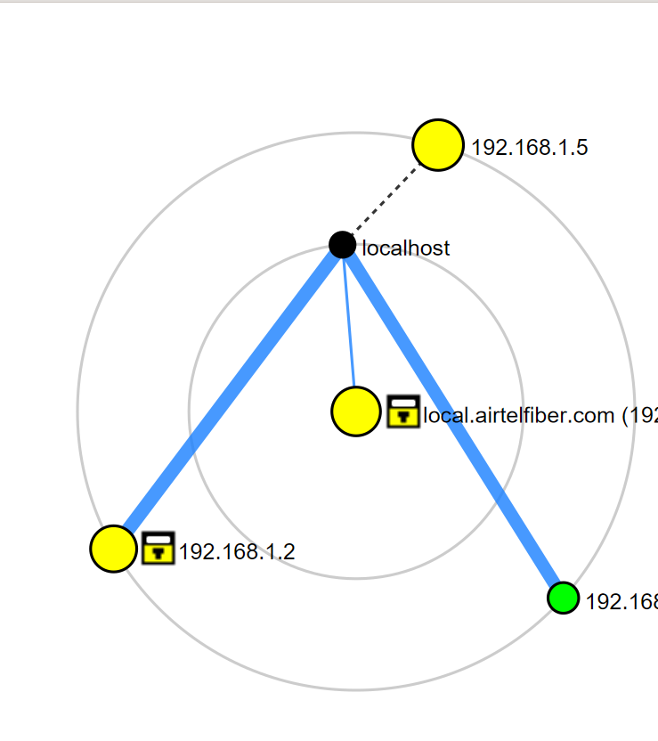
Map Topology
What is map topology?
Network topology mapping is a visual representation of the layout of your network, including all devices, connections, and communication paths. This visual representation is often called a network map, and it helps you understand how different network components interact with each other and how data flows within the network.
For visual representation of network we can use Zenmap tool.
In the image of visual representation of network , we can see that four devices are connected to network

Slide 4
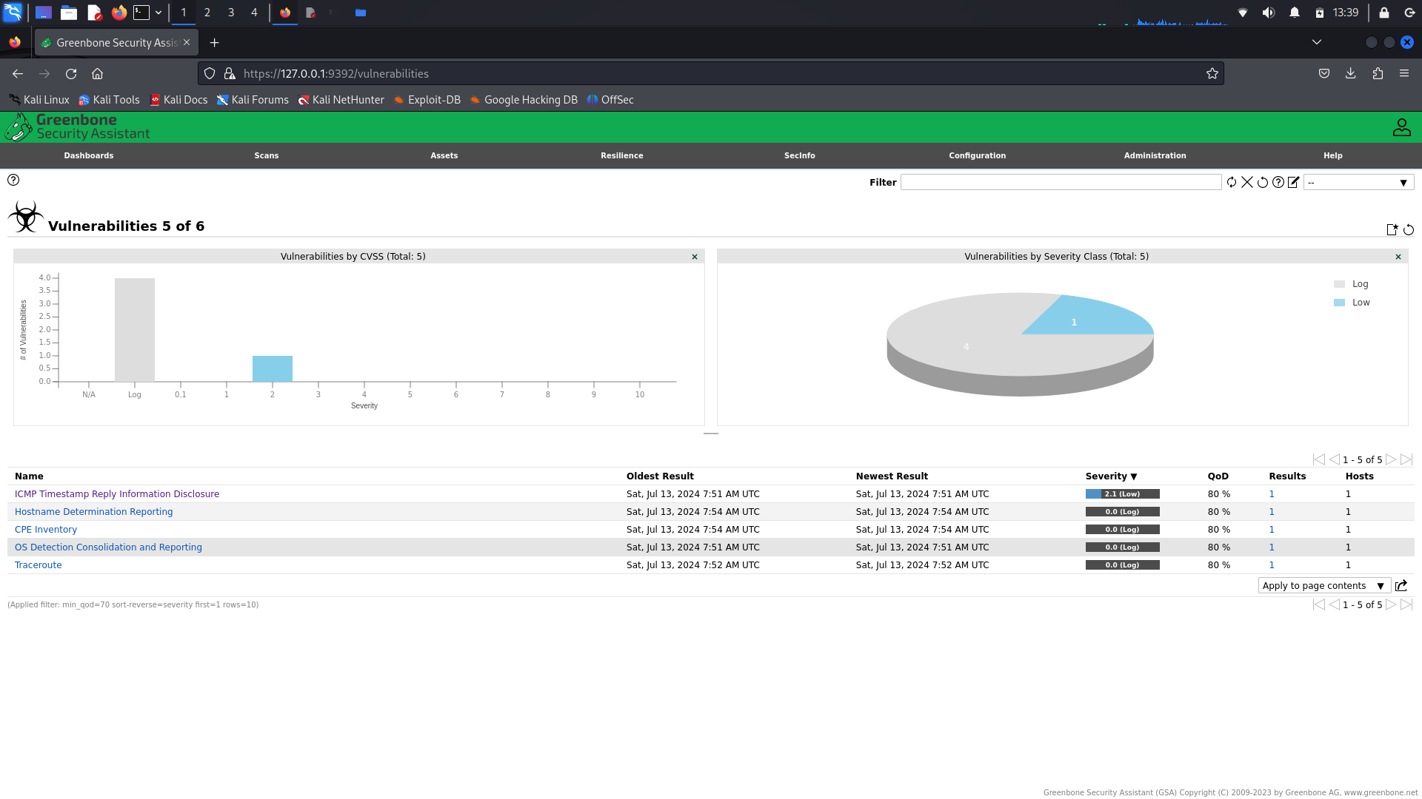
Vulnerability Scan
Nessus, OpenVAS, QualysGuard, Rapid7 Nexpose, and Nikto.
What is vulnerability scanning ?
A vulnerability scan involves the systematic examination of a network, system, or application to identify security gaps that could be exploited by an attacker. This process uses automated tools to detect potential vulnerabilities such as outdated software, misconfigurations, and unpatched vulnerabilities.
Many popular tools are there to find vulnerability of target system like : Nessus, OpenVAS, QualysGuard,Rapid7 Nexpose and Nikto
We use OpenVAS tool to find the vulnerability of target system that are scanned .
In this image we can see the vulnerability of target system which was scanned by the tool OpenVAS
We found a low level vulnerability (2.1 severity) of ICMP (The Internet Control Message Protocol).

Slide 5
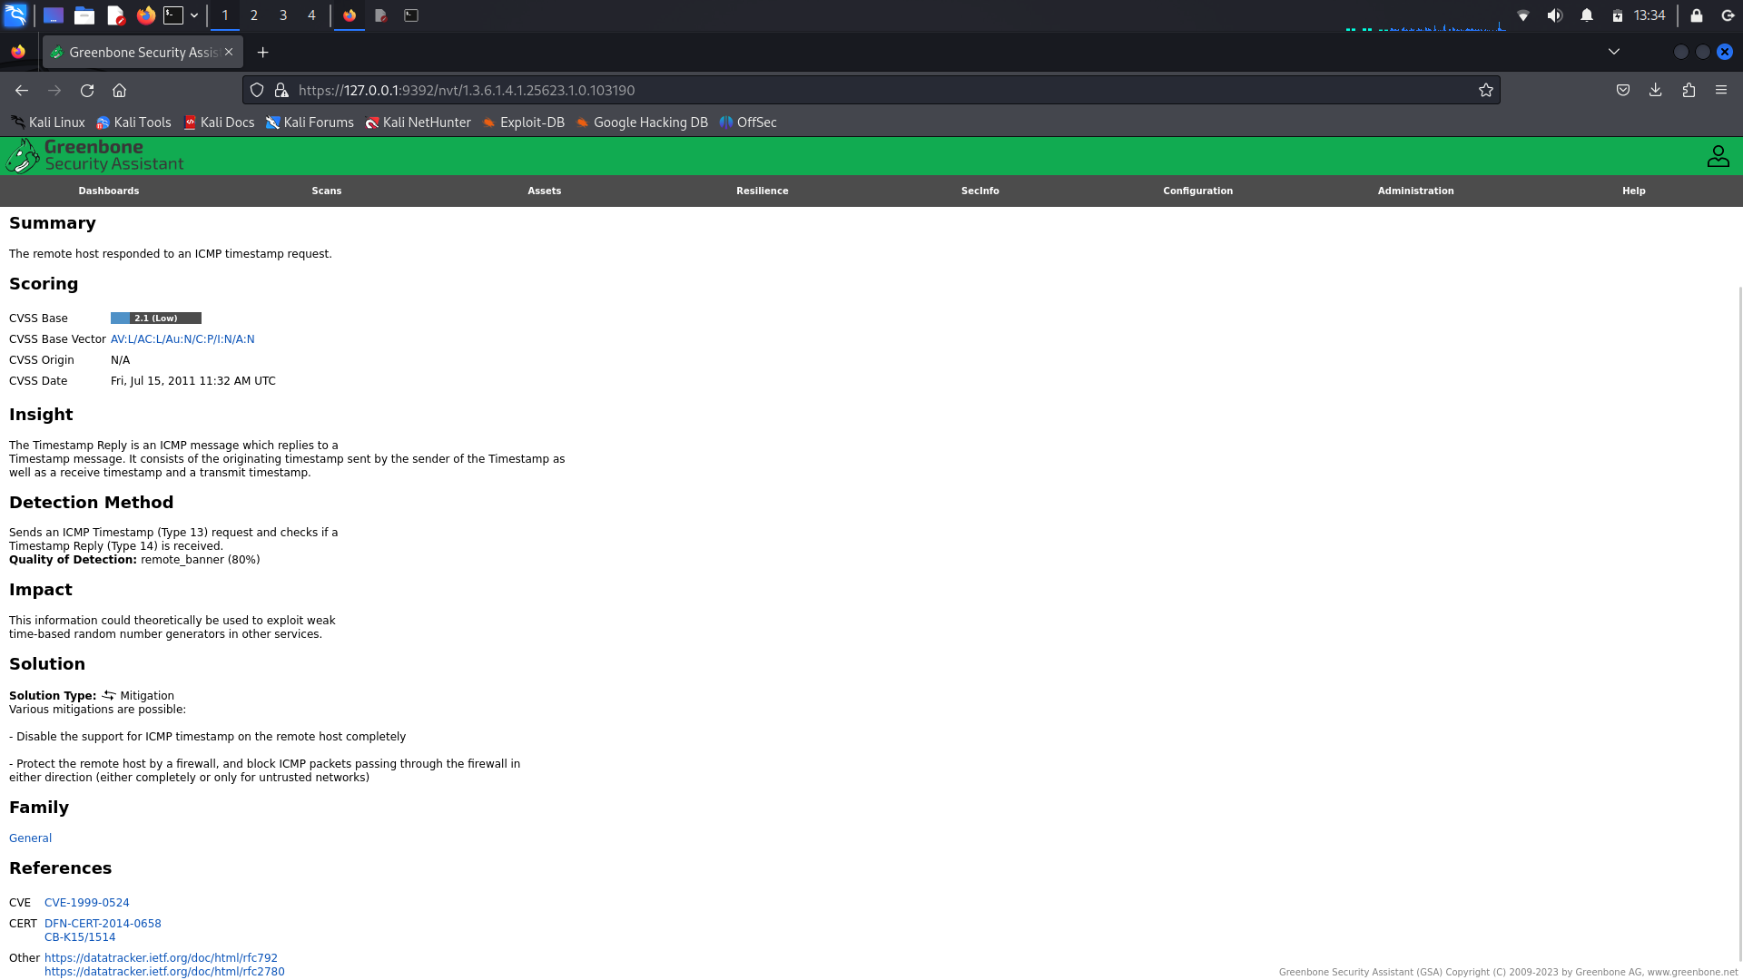
Vulnerability and solutions
In OpenVAS tool the scanning of target system helps us to find vulnerability of system with proper reports of scanning and suggest you a solution which can help us to improve the security posture of the system
In image that has been provided are the vulnerability of the system with detection methods ,impact on system and the solution to improve security of the system and resolve the problem
In this report of vulnerability we found the vulnerability of ICMP (The Internet Control Message Protocol).
The detection method was it sends an ICMP timestamp (type 13) request and check if timestamp reply (type 14) is received , the quality of detection was remote_banner 80%
Impact on the system because of this vulnerability is that it cloud be used to exploit weak time – based random number generators in other services
Solution of this is mitigation , there are various mitigation processes like : disable the support for ICMP timestamp on the remote host completely

Slide 6
Conclusion
Network discovery and mapping activities revealed several critical and critical vulnerabilities that require immediate attention. By addressing these vulnerabilities and implementing the recommended security measures, the security posture of the network can be significantly improved.

Slide 7
THANK YOU
Present by : Kushagra Pandurang Pitre
Intern : andintern
Contact no. 9766695361
Email : kushagrapitre2@gmail,com
Date : 13/07/2024

